Slide 1

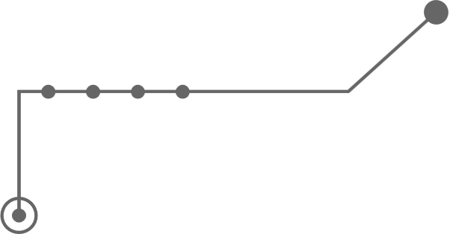


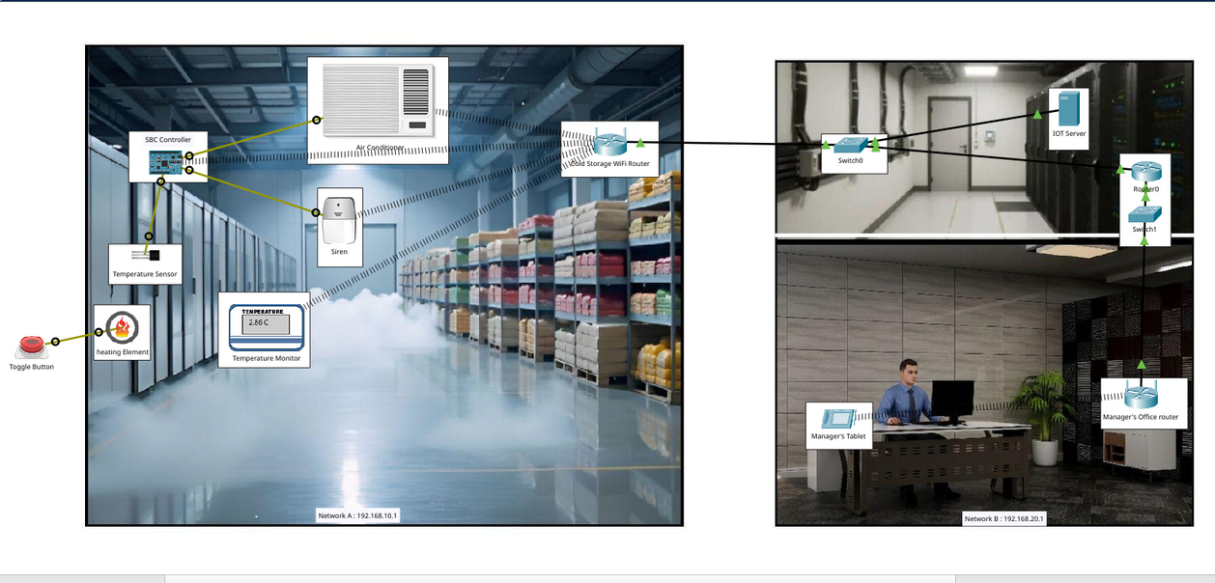






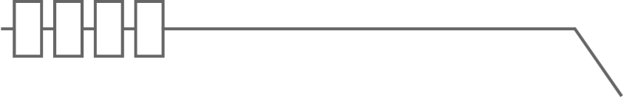

Smart Cold Storage Temperature Protection System
Group D
ID 23701011
ID 23701017
ID 23701003
ID 23701007
ID 23701013
01

Slide 2




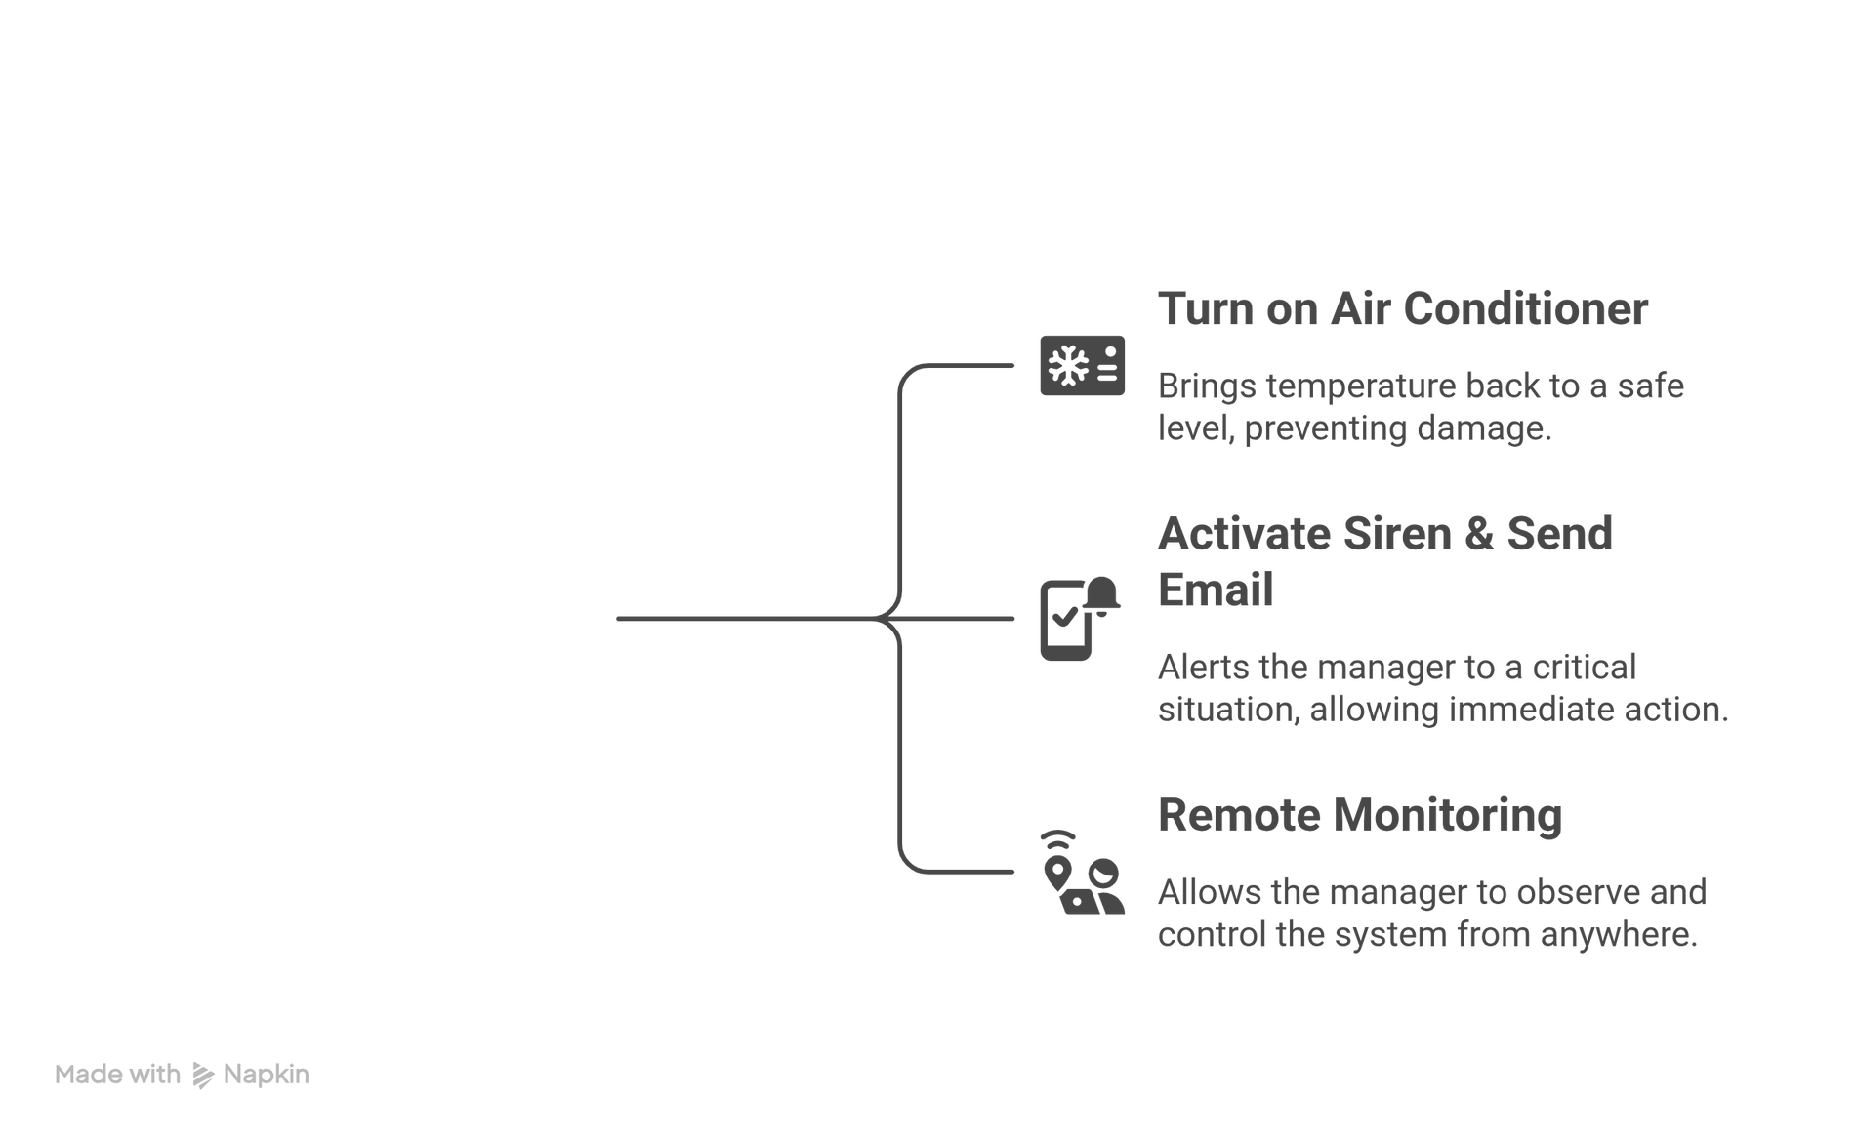


Project Introduction
02

Slide 3


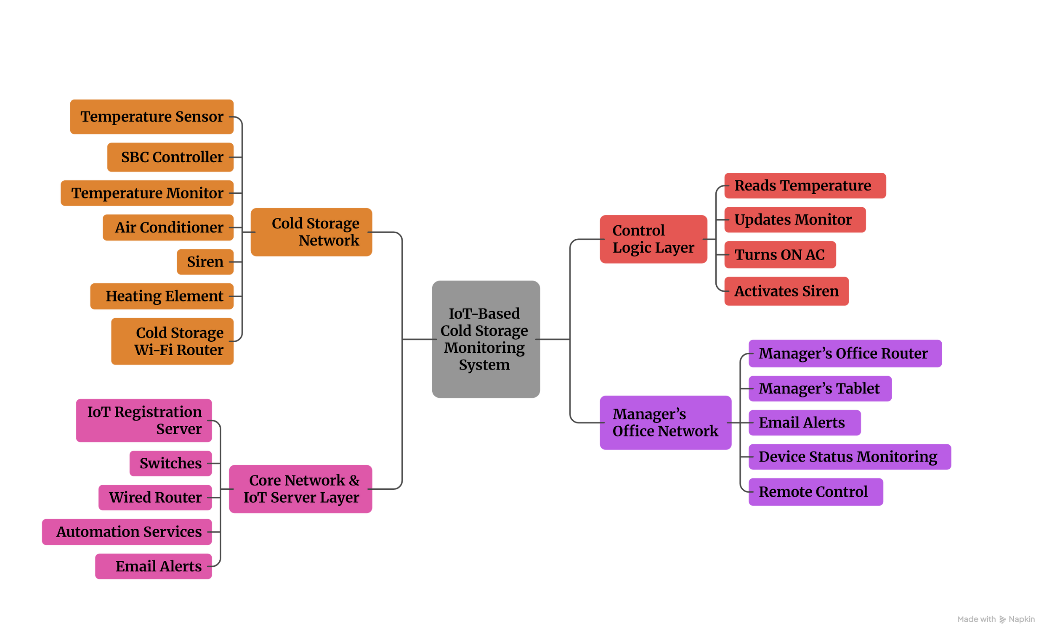



IoT System Architecture
03

Slide 4




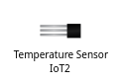
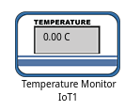
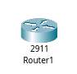


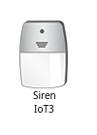

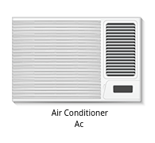

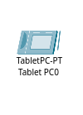




IoT Devices and Their Roles
Wireless Router
Router
Switch
Temperature Sensor
Temperature Monitor
Displays real-time temperature
Connects Cold Storage and Manager’s Office networks
Provides wired connectivity between server and router
Continuously senses temperature
Connects IoT devices to the network
SBC
Siren
Server
Air Conditioner
Runs automation logic
Device registration & control
Alerts critical condition
Cools storage automatically
Button
Heating Element
Tablet
Manager monitoring & control
Manually controls heating element for testing
Simulates temperature increase in the environment
04

Slide 5




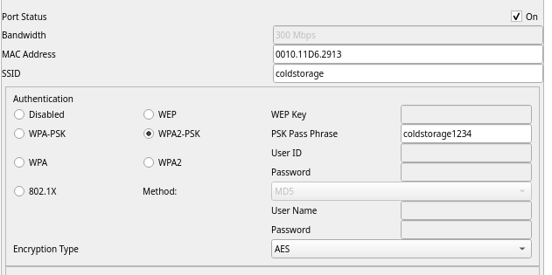
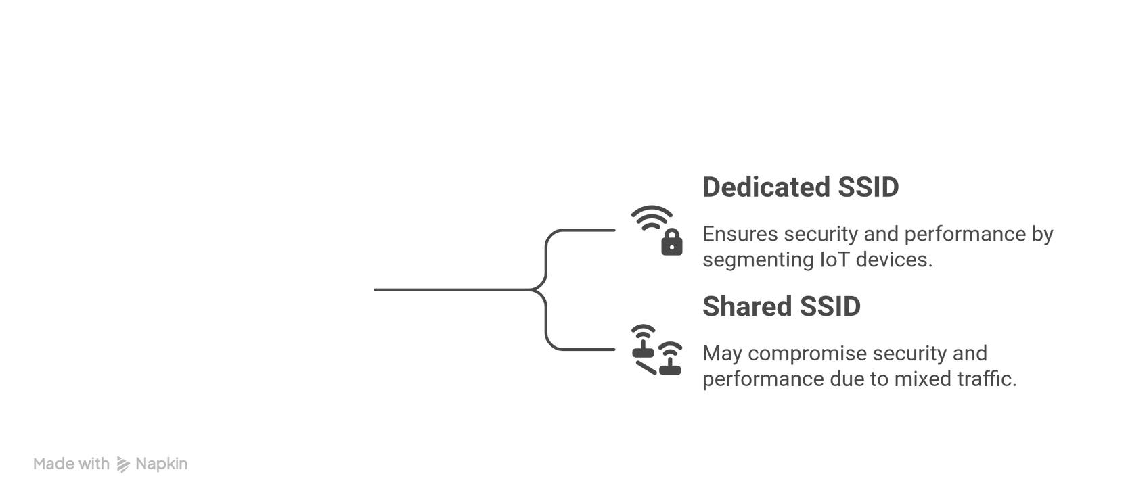
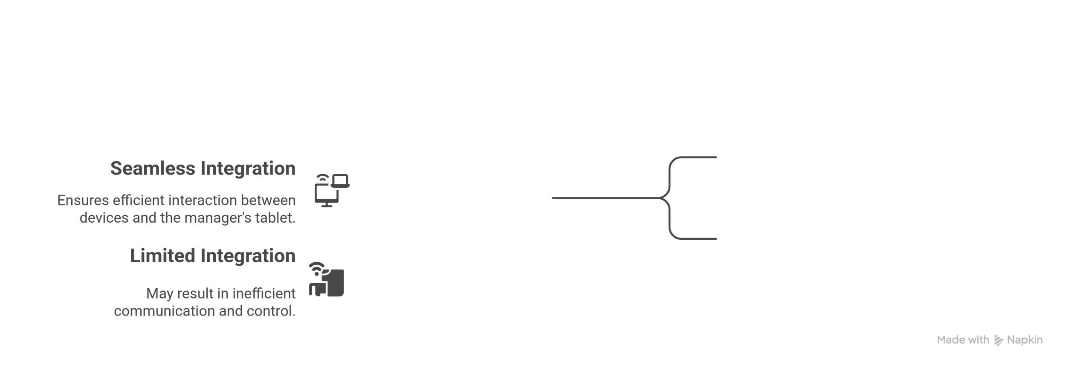
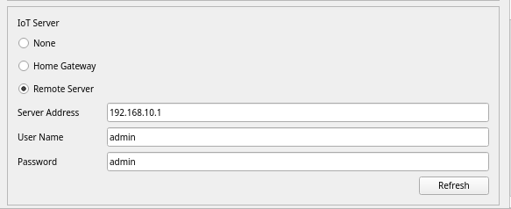
Device Configuration
05

Slide 6




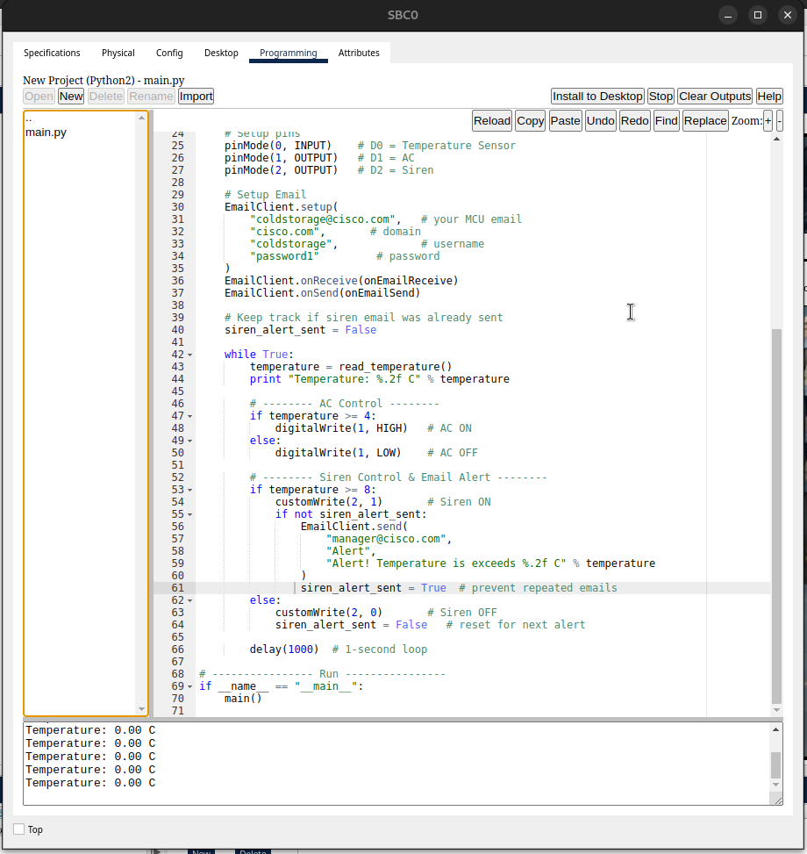
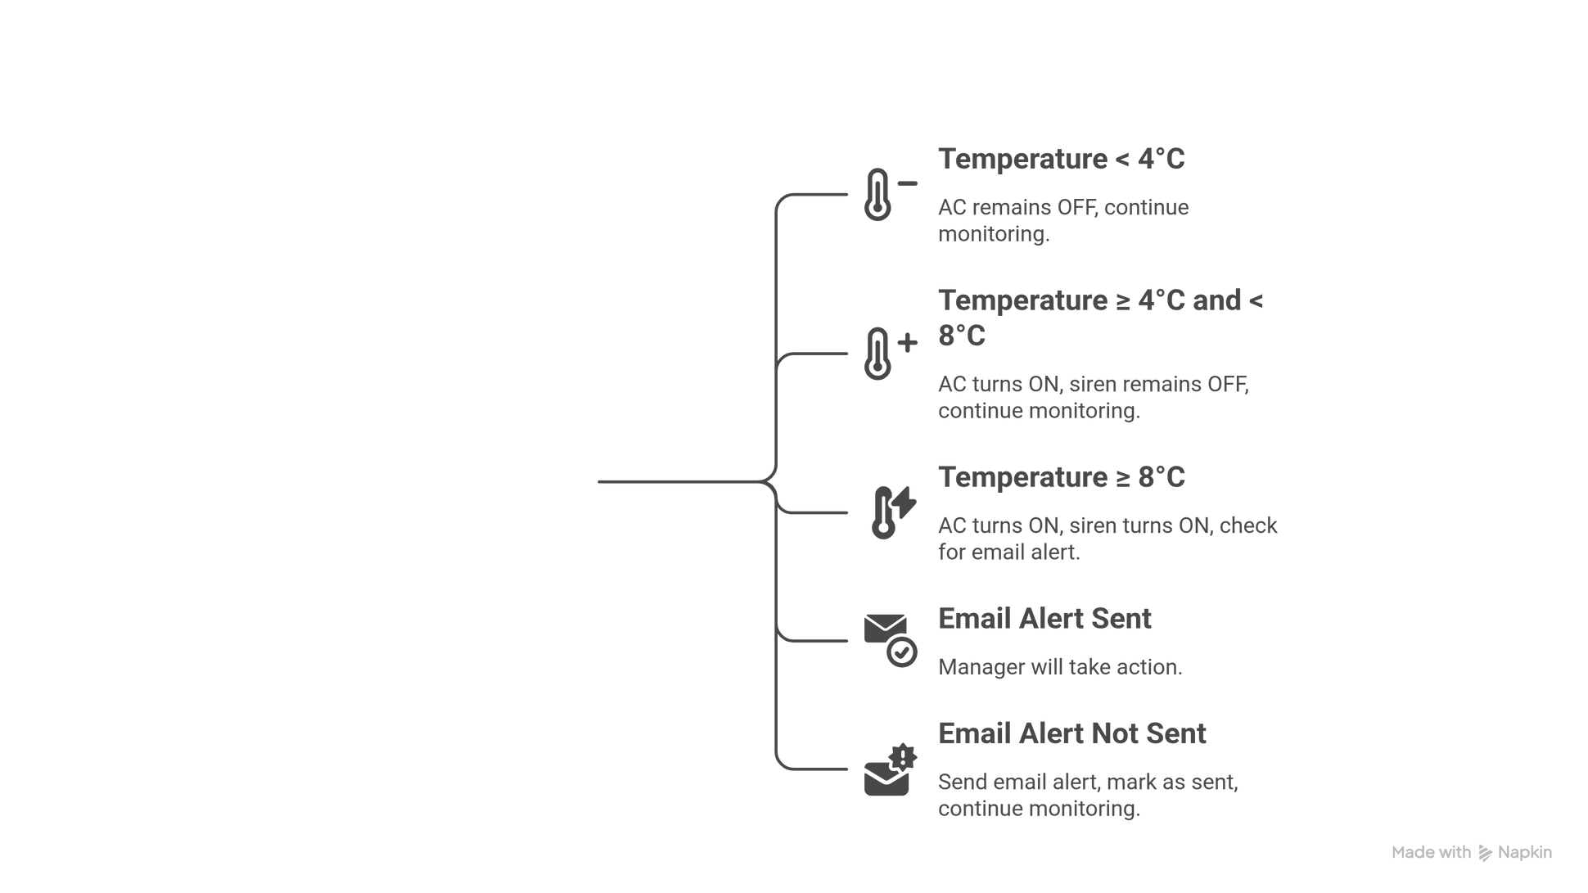


SBC Programming Logic
06

Slide 7



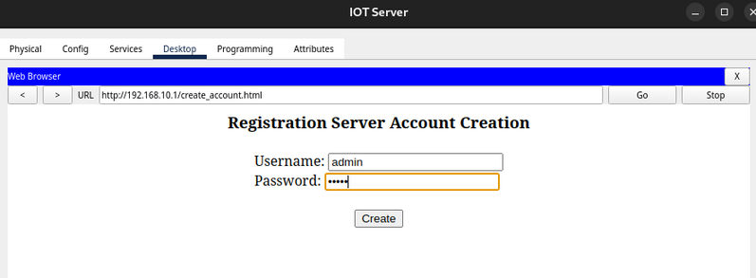

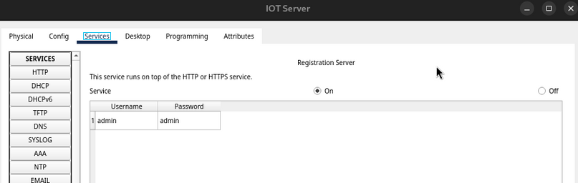

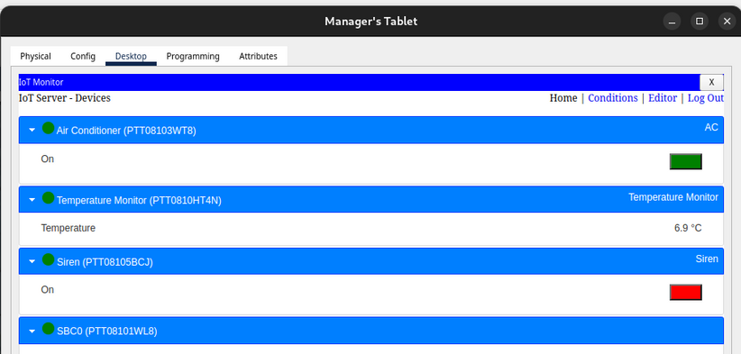
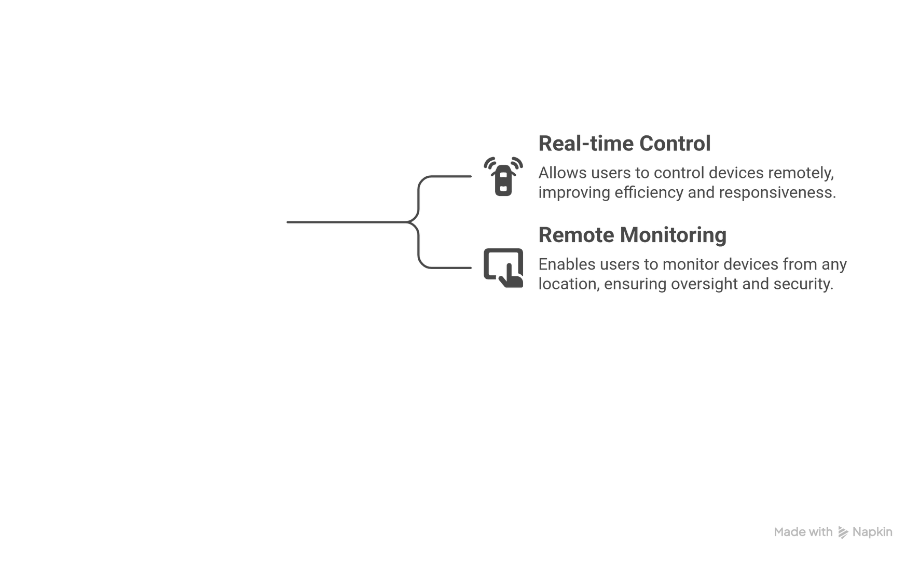


IoT Server Configuration & Device Control
07

Slide 8

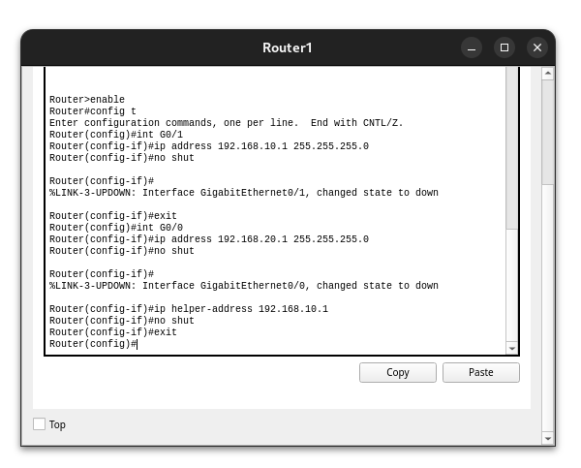

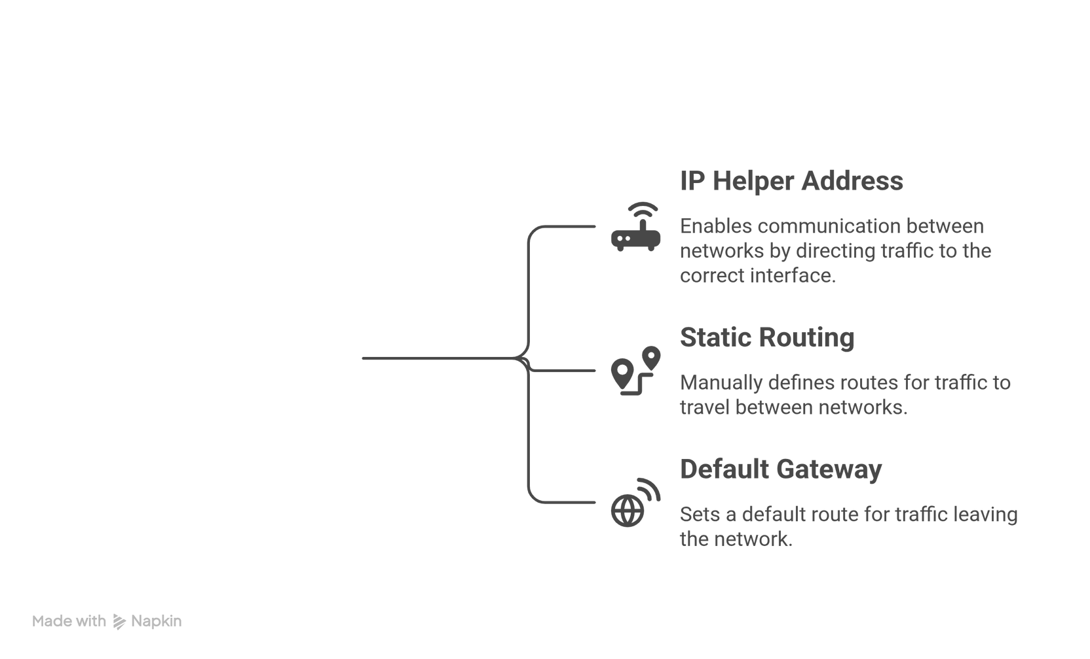


Network & Router Configuration
08

Slide 9


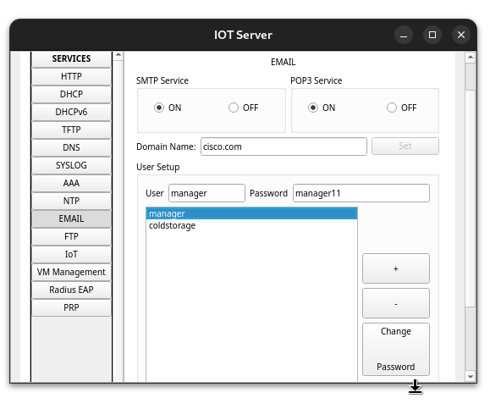

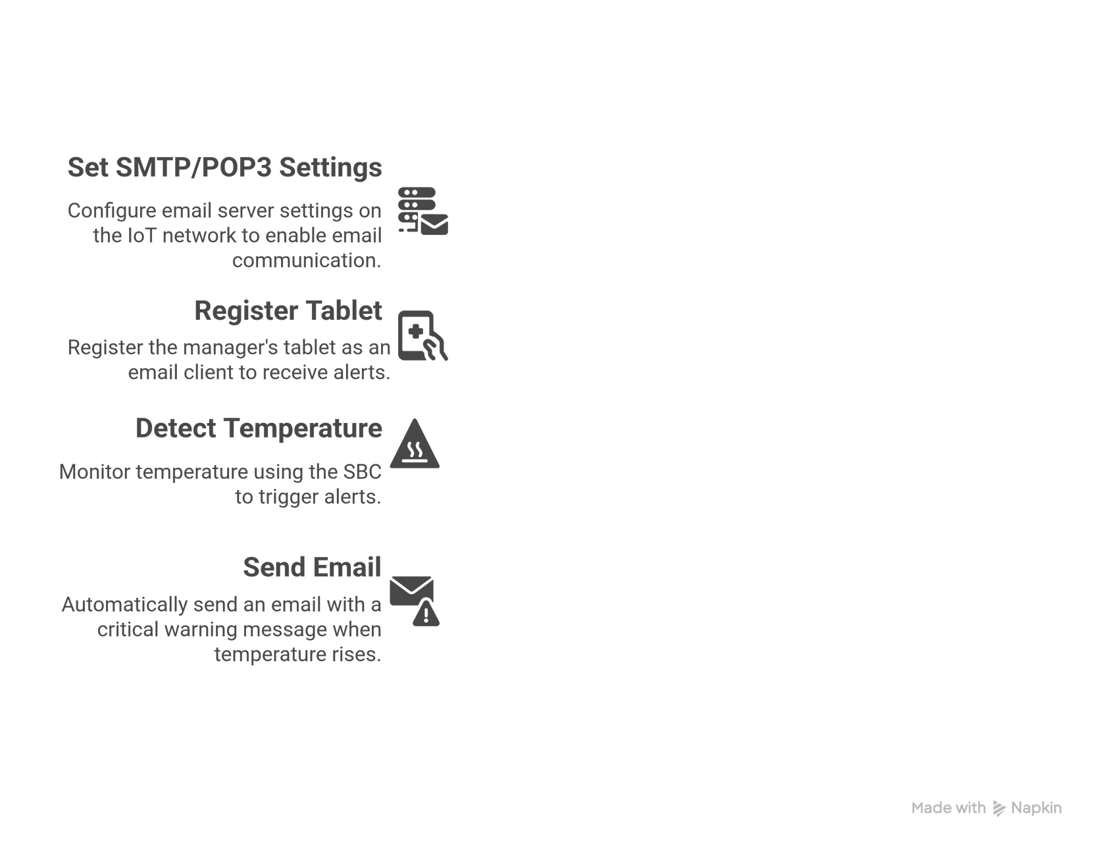
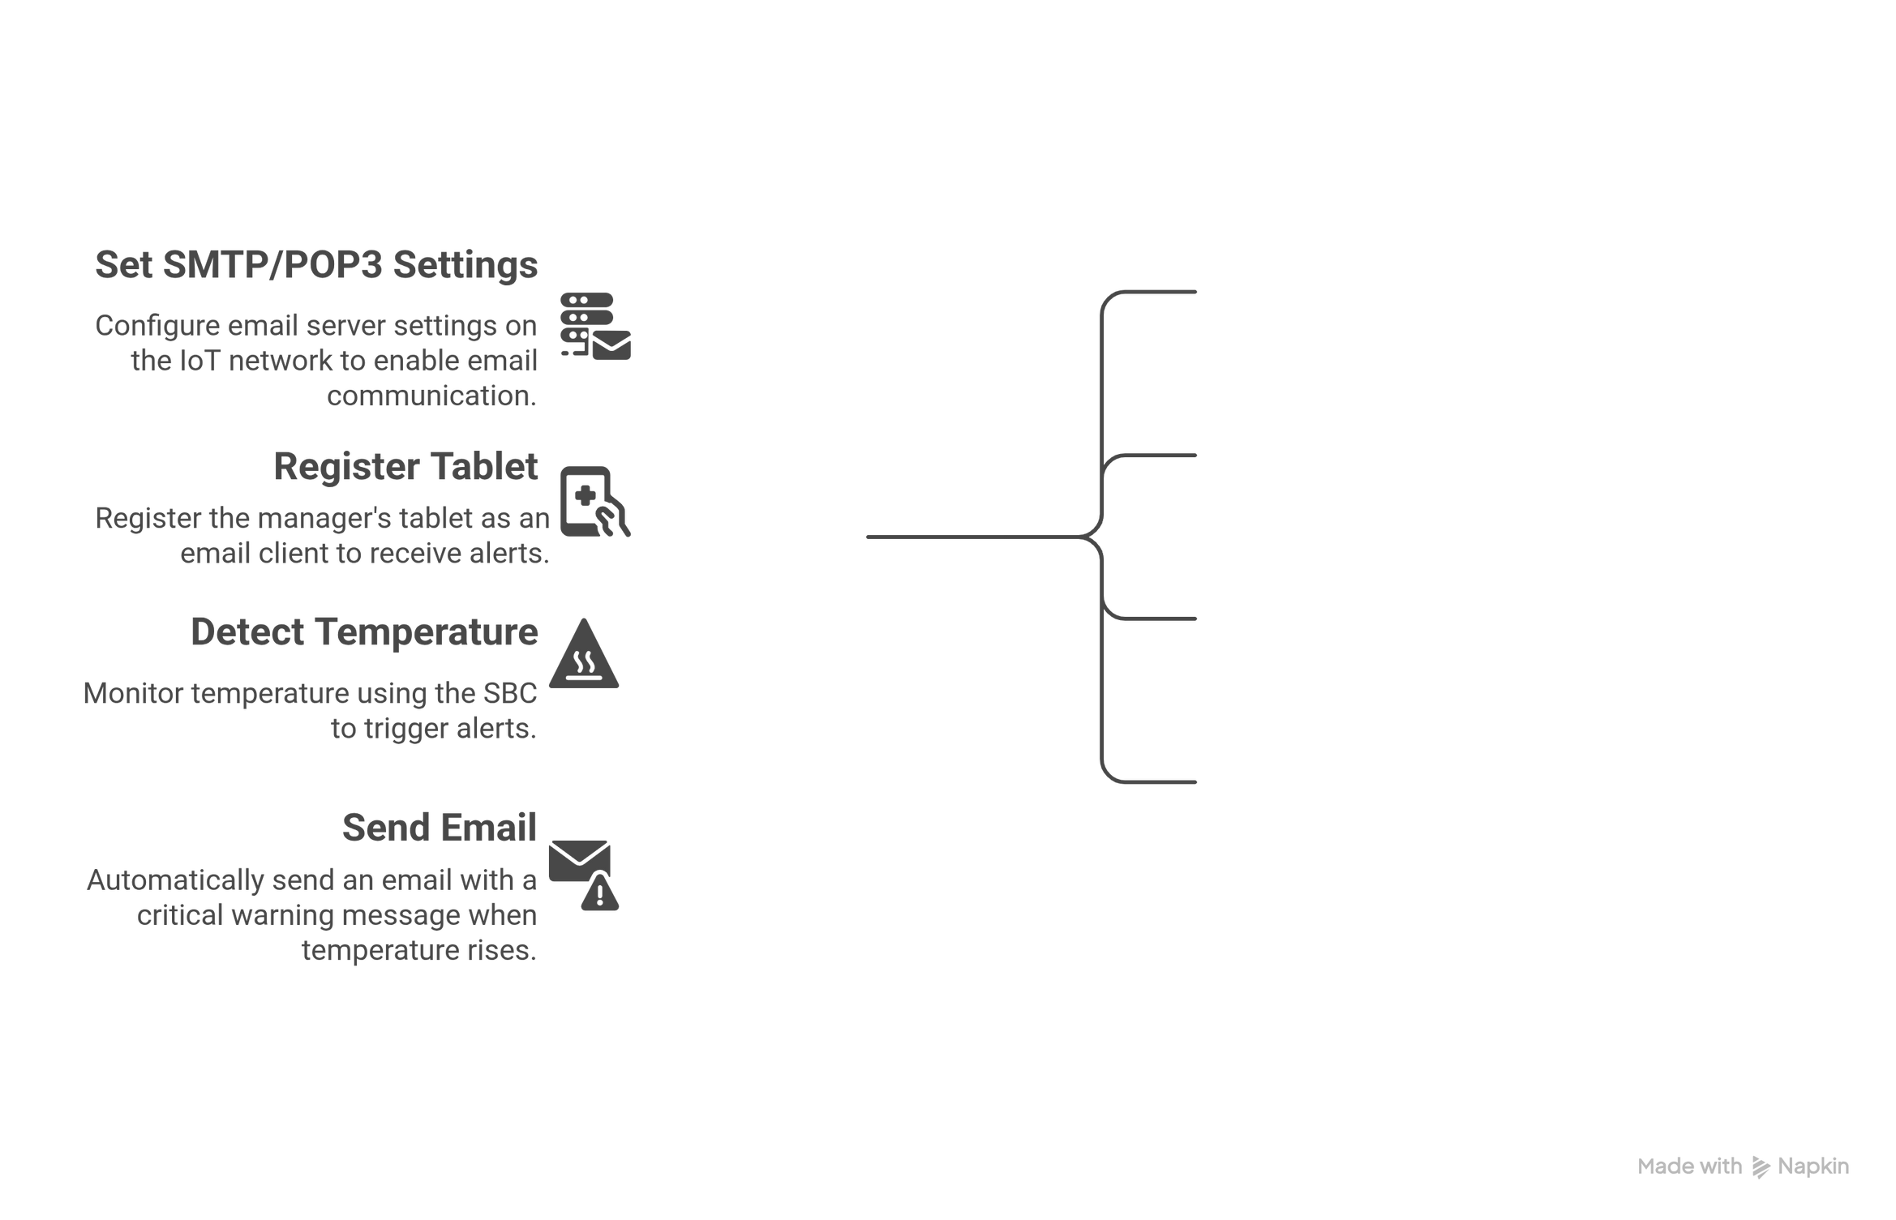

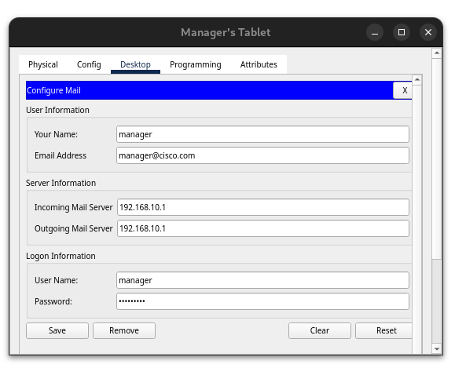
Email Server & Alert Mechanism
09

Slide 10
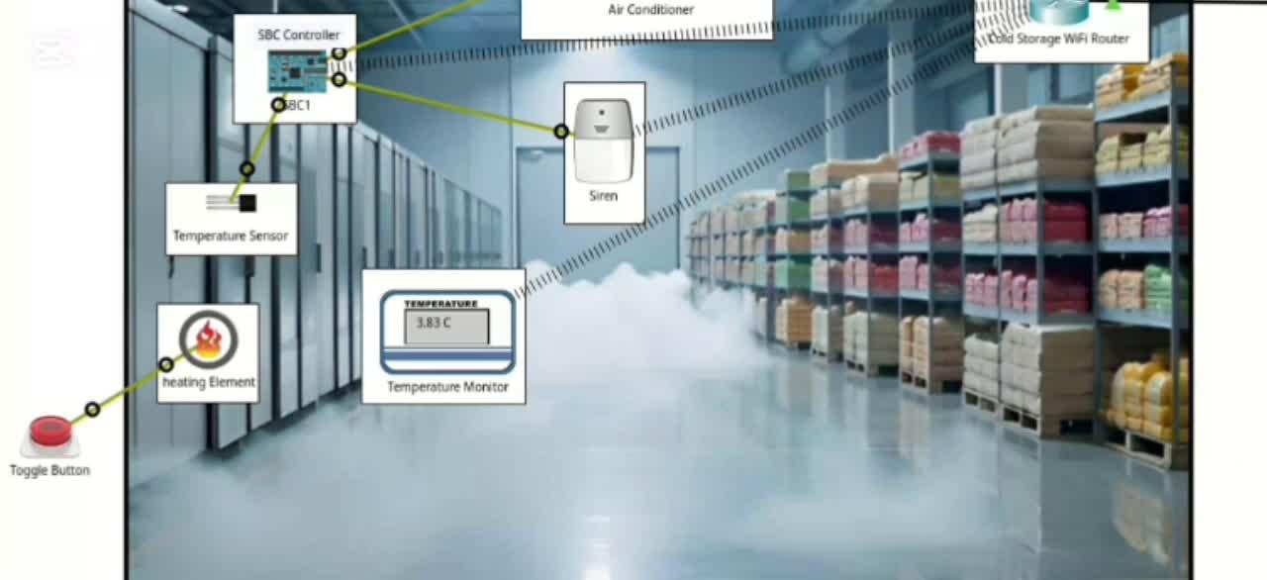

System Simulation
10

Slide 11



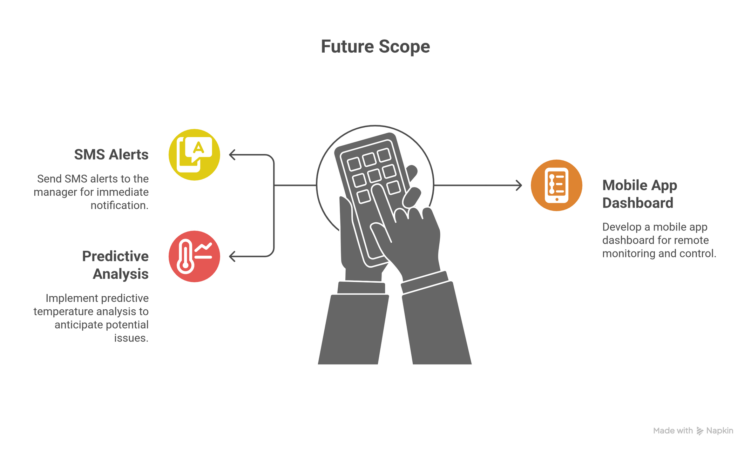


Conclusion & Future Scope
The system works correctly and provides automatic temperature monitoring, cooling control, and timely alerts for efficient cold storage management.
11

Slide 12

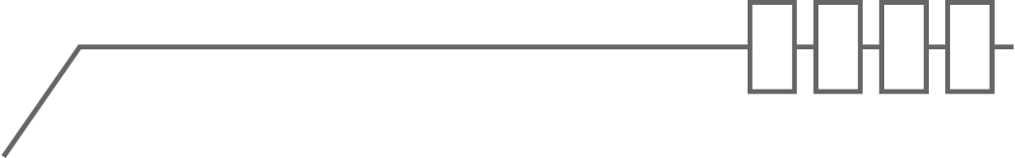


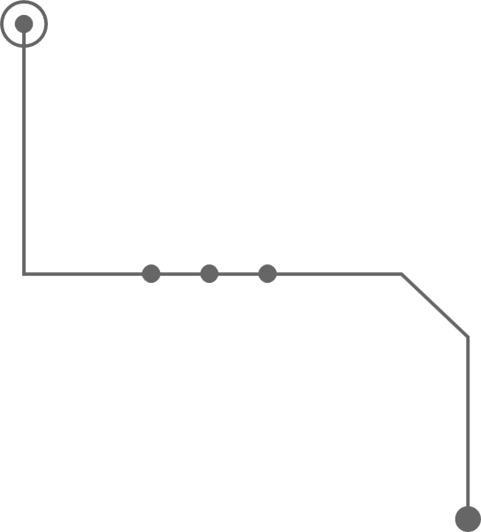





Thank You
12

